Slide 1

HOW 2+1 ROADS SAVE MONEY, TIME, AND LIVES
William Dunstan
Northern policy institute
Notes:
NPI is a public policy think tank based in Northern Ontario and focused on issues impacting Northern Ontario
One big issue in Northern Ontario, as in other rural and northern regions of Canada, is road safety.
In recent years, advocates in Northern Ontario have promoted 2+1 roads as a safer road design. In response, we did an analysis of whether 2+1 roads represent good investments, and under what conditions. The answer is they often are good investments.

Slide 2
Why 2+1 Roads
Problem: many roads in rural and northern regions are too heavily trafficked to operate as two-lane roads, but not trafficked enough to justify the high cost of highway twinning
Solution: 2+1 roads provide an intermediate option between two-lane roads and twinned highways
2+1 roads provide similar traffic flow and safety benefits as highway twinning at a much lower cost
  In Sweden, the 2+1 configuration has been shown to save one life per $150,000 spent, compared to one life per $4.5 million for highway twinning
Notes:
Will show you how 2+1 roads work on the next couple slides
2+1 roads are used in Sweden, Finland, Ireland and other countries
If 2+1 roads can save a life at 1/30th of the cost, that’s a significant advantage – may be somewhat inflated by selection bias

Slide 3
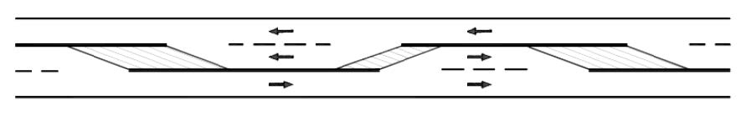
How 2+1 Roads Work
There are three lanes on a 2+1 road.
  The middle lane acts as a passing lane and alternates directions every few kilometres
The two directions of traffic are separated by a barrier
Schematic of a 2+1 road
Notes:
2+1 roads are simple – see the schematic at the bottom
Head on collisions from vehicles trying to pass unsafely is a major problem – 2+1 (1) provides safe passing opportunities (2) separates directions of traffic

Slide 4
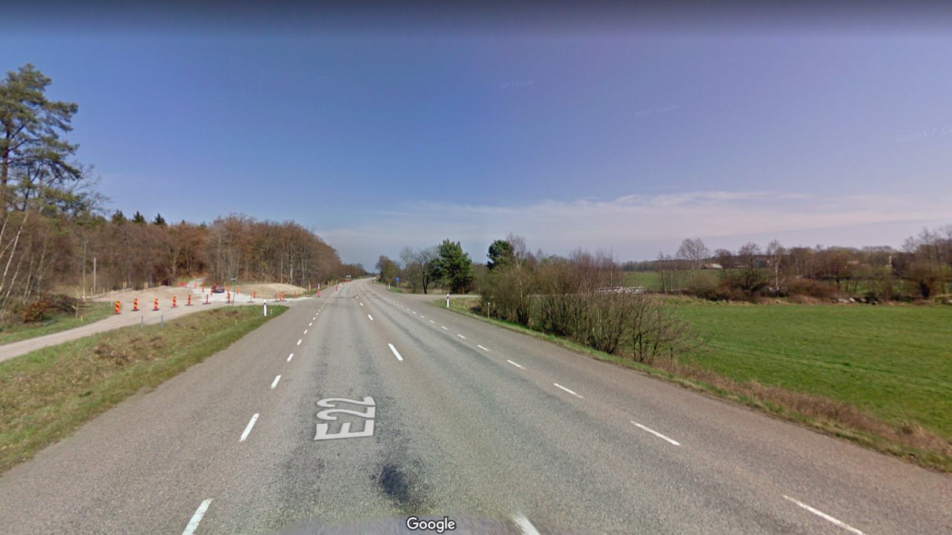
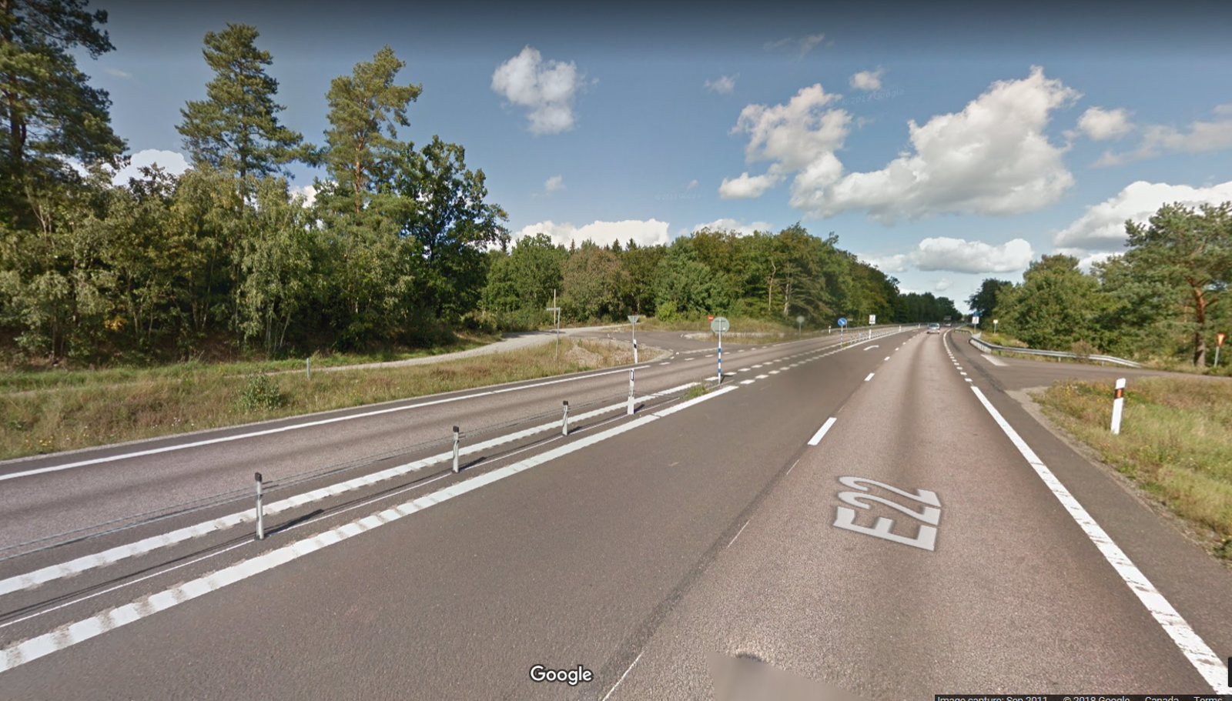
Example of a 2+1 Road in Sweden
Two-lane road before 2+1 conversion
After 2+1 conversion
Notes:
From two lanes to three
Median barrier installed
Break in the median barrier at the intersection – 2+1 roads do not need to be controlled access (advantage in less populated areas where the highway is also the local road / doesn’t need to bypass towns)

Slide 5
Advantages of 2+1 Roads
Safety
  Upgrading two-lane roads to a 2+1 configuration reduces fatal and serious injury collisions by 40 to 80 per cent
Improved traffic flow
  Regular passing lanes
  Fewer serious accidents = fewer extended road closures
Reminder: 2+1 roads achieve this at a significantly lower cost than highway twinning
  The main saving comes from not needing to build a second, parallel road

Slide 6
Where Does 2+1 Work?
Our research suggests 2+1 roads are usually the best road design option on roads with traffic volumes between 3,000 and 20,000 vehicles per day
  Below 3,000, two-lane roads are usually the best option
  Above 20,000, multi-lane divided highways work best
But traffic volumes are not the only variable. Other factors to consider include:
  Terrain and the cost of construction
  Collision rates on the existing road
  Presence of alternative routes in the event of road closures
Notes:
Mentioned earlier that 2+1 is an intermediate solution between 2-lane and twinning, what exactly does that mean?
Best = greatest benefits relative to costs
More expensive to build = worse b/c ratio, lots of head-on collisions = greater returns from safety improvements, no alternative route = greater benefit from preventing road closures

Slide 7
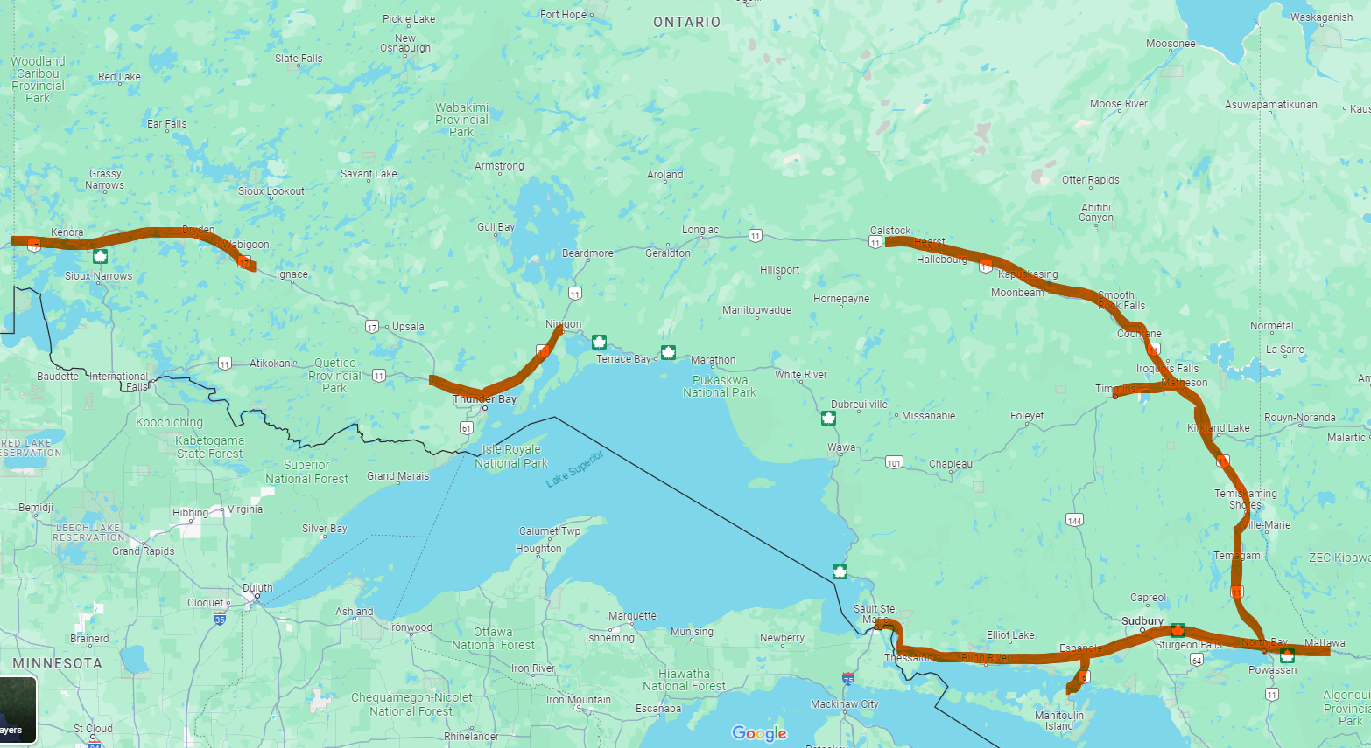
Where 2+1 Should be Introduced in Northern Ontario
NPI identified the following roads in Northern Ontario where upgrading to 2+1 would provide a positive benefit-cost ratio:
Highway 17 from Mattawa to Sault Ste. Marie
Highway 101 between Timmins and Highway 11
Highway 11 from North Bay to slightly west of Hearst*
Highway 11/17 from Nipigon to Shabaqua Corners
Highway 17 and 17A from the junction of highways 17 and 72 to the Manitoba border
Highway 6 from Little Current to Espanola
*The Ontario government will pilot the 2+1 road model on one section of this road
Map of roads where 2+1 should be introduced
Notes:
In short, most of the major highways in Northern Ontario
These roads are all two-laned, but a few sections are actively being twinned.
When we make a case for 2+1 roads, we are not simply saying “more money for NO roads”. Some roads do need greater investment, but for roads that are set to be twinned, 2+1 is a way to spend less money to get similar results.

Slide 8
Where else in Canada could 2+1 roads be a good option?
Solely considering traffic volumes, below are some examples of roads outside of Northern Ontario that could be suitable for 2+1 :
In British Columbia
  Much of Highway 16
  “Cariboo Highway” section of Highway 97
In Southern Ontario
  Highway 3 along Lake Erie
  Highway 21 along Lake Huron
  Highway 7 in Eastern Ontario
In New Brunswick
  Many sections of Route 8 and 11
Notes:
Realize that most participants aren’t from Northern Ontario, so NO roads might not be the best frame of reference
To better communicate what type of roads are good fits for 2+1, I have listed a few roads in other parts of Canada
Haven’t done as rigorous of analysis. This list is just based on traffic volumes.

Slide 9

Thank you. Marsee. ᑭᓇᓈᐢᑯᒥᑎᐣ Merci. Miigwech.
1 (807) 343-8956 | info@northernpolicy.ca
www.northernpolicy.ca
/NorthernPolicy
Notes:
2+1 roads can save motorists time, and more importantly they save lives
And they do this at a lower cost than highway twinning
Happy to take questions

