Slide 1


Data & Descriptive Statistics
Francophone Demographics
June 18th, 2018. Rachel Armstrong

Slide 2
Data & Descriptive Statistics: Disclaimer
Data from Statistics Canada is used in this presentation. This data source has limitations. To ensure confidentiality of individual respondent identity and characteristics, Statistics Canada data is subject to non-disclosure rules. All estimates are subjected to a process called random rounding, which transforms all raw estimates to random rounded estimates. This reduces the possibility of identifying individuals within the tabulations. All estimates greater than 10 are rounded to base 5. Estimates less than 10 are rounded to base 10. The total value of summed or grouped data may not match the individual values. Similarly, percentages, which Statistics Canada calculates on rounded data, may not necessarily add up to 100 percent. Statistics Canada adjusts figures retroactively. Author’s calculations are based on data available at the time of publication and are therefore subject to change.
Statistics Canada data sources include:
-Census Profile 2016, (Obtained through Statistics Canada)
-Target group profile of the Francophone population, Census, 2016 (Obtained through the Community Data Program)

Slide 3
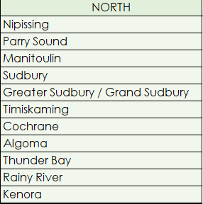
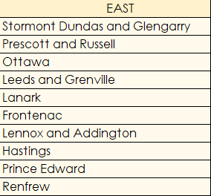
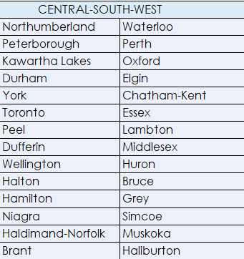
Census districts within Francophone Immigration Support Networks
Réseau de soutien à l’immigration francophone du Nord de l’Ontario:
Réseau de soutien à l'immigration francophone du Centre-Sud-Ouest de l'Ontario:
Réseau de soutien à l’immigration francophone:

Slide 4
Data & Descriptive Statistics
  Francophones make up:
  17% of the population in Northern Ontario
  16% of the population in Eastern Ontario
  2% of the population in Central-South-West
Source: Author's calculations based on Statistics Canada, Target group profile of the Francophone population, Census, 2016, and Authors calculations based on Statistics Canada, Census of Population, 2016

Slide 5
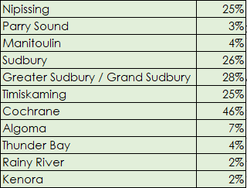
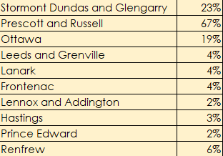
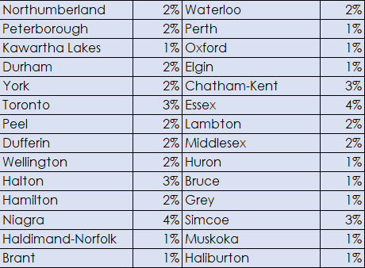
Data & Descriptive Statistics: Francophone % per census district
Réseau de soutien à l’immigration francophone du Nord de l’Ontario:
Réseau de soutien à l'immigration francophone du Centre-Sud-Ouest de l'Ontario:
Réseau de soutien à l’immigration francophone:
Source: Author's calculations based on Statistics Canada, Target group profile of the Francophone population, Census, 2016, and Authors calculations based on Statistics Canada, Census of Population, 2016

Slide 6
Data & Descriptive Statistics: Targeted geographies
  Northern Ontario
  Francophones make up:
  23% of Northeast Ontario ( Algoma, Sudbury, Cochrane, Timiskaming, Nippissing, Manitoulin & Parry Sound)
  3% of Northwest Ontario (Kenora, Rainy River, Thunder Bay)
Source: Author's calculations based on Statistics Canada, Target group profile of the Francophone population, Census, 2016, and Authors calculations based on Statistics Canada, Census of Population, 2016

Slide 7
Data & Descriptive Statistics: Targeted geographies
  Eastern Ontario
  Francophones make up:
  19% of the population in Ottawa
  4% of the population in Frontenac (Kingston CD)
  42% of the population in SDGPR (Stormont Dundas and Glengarry, Prescott and Russell)
Source: Author's calculations based on Statistics Canada, Target group profile of the Francophone population, Census, 2016, and Authors calculations based on Statistics Canada, Census of Population, 2016

Slide 8
Data & Descriptive Statistics: Targeted geographies
  C-S-W Ontario
    Francophones make up:
  3% of the GTA ( Durham, Dufferin, Halton, Simcoe, Peel, York & Toronto)
  2% of London-Sarnia (Middlesex & Lambton)
  2% of Hamilton
  4% of Niagra
Source: Author's calculations based on Statistics Canada, Target group profile of the Francophone population, Census, 2016, and Authors calculations based on Statistics Canada, Census of Population, 2016

Slide 9
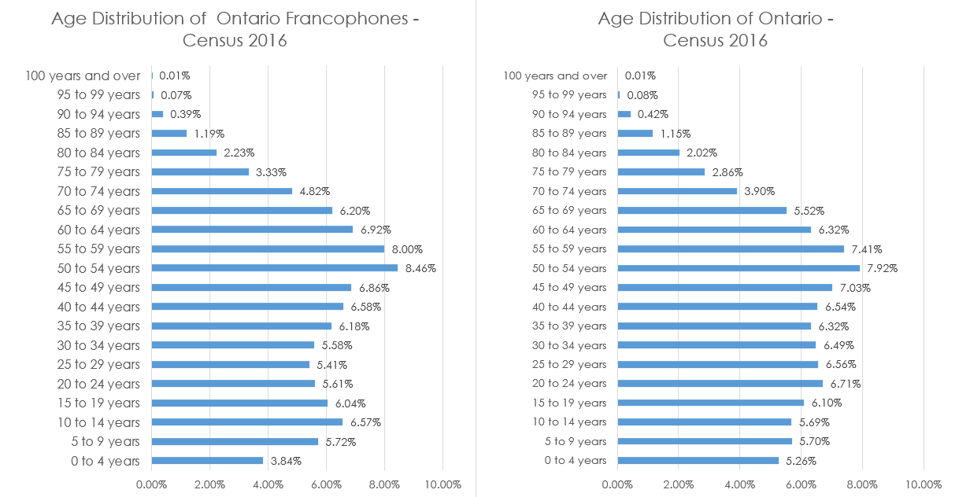
Data & Descriptive Statistics: Age - Ontario
Source: Author's calculations based on Statistics Canada, Target group profile of the Francophone population, Census, 2016, and Authors calculations based on Statistics Canada, Census of Population, 2016

Slide 10
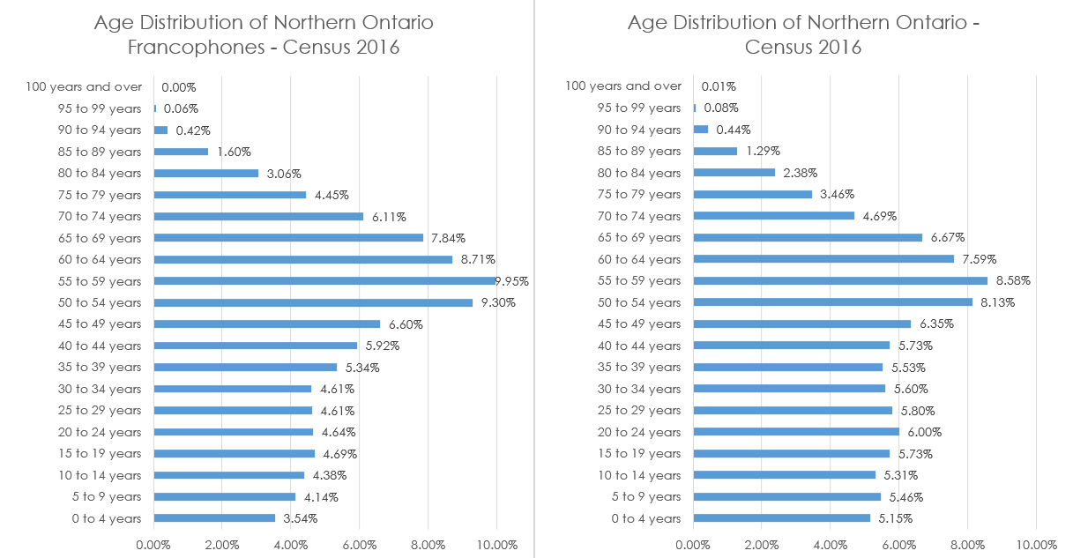
Data & Descriptive Statistics: Age - Northern Ontario
Source: Author's calculations based on Statistics Canada, Target group profile of the Francophone population, Census, 2016, and Authors calculations based on Statistics Canada, Census of Population, 2016

Slide 11
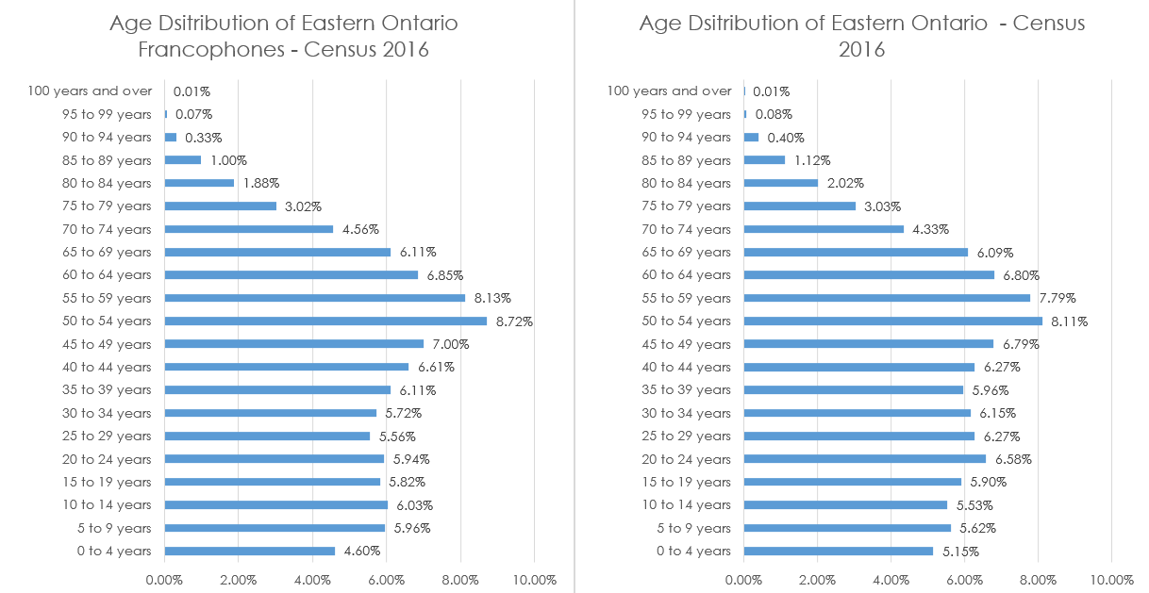
Data & Descriptive Statistics: Age - Eastern Ontario
Source: Author's calculations based on Statistics Canada, Target group profile of the Francophone population, Census, 2016, and Authors calculations based on Statistics Canada, Census of Population, 2016

Slide 12
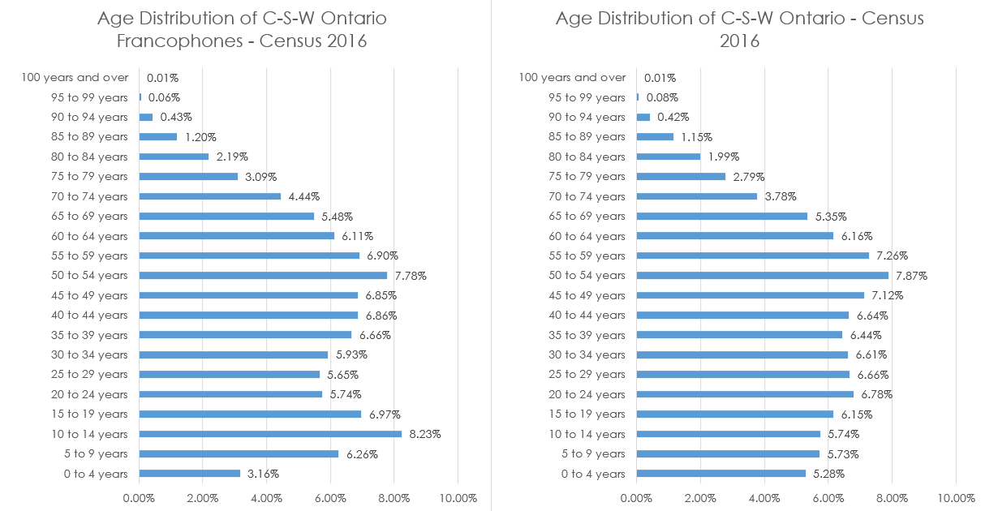
Data & Descriptive Statistics: Age – C-S-W Ontario
Source: Author's calculations based on Statistics Canada, Target group profile of the Francophone population, Census, 2016, and Authors calculations based on Statistics Canada, Census of Population, 2016

Slide 13
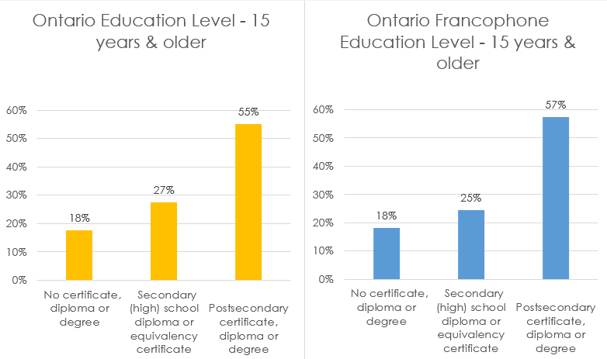
Data & Descriptive Statistics: Education – Ontario
Source: Author's calculations based on Statistics Canada, Target group profile of the Francophone population, Census, 2016, and Authors calculations based on Statistics Canada, Census of Population, 2016

Slide 14
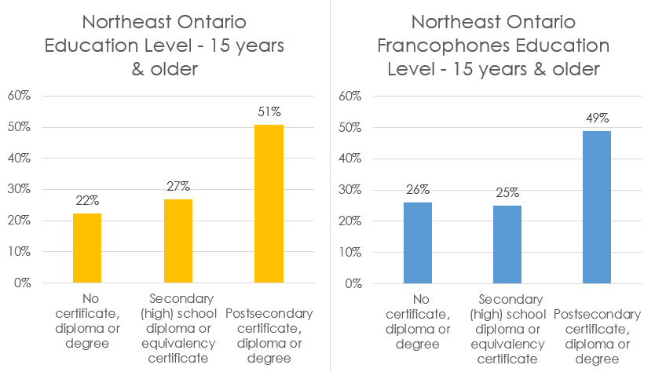
Data & Descriptive Statistics: Education – Northeast Ontario
Source: Author's calculations based on Statistics Canada, Target group profile of the Francophone population, Census, 2016, and Authors calculations based on Statistics Canada, Census of Population, 2016

Slide 15
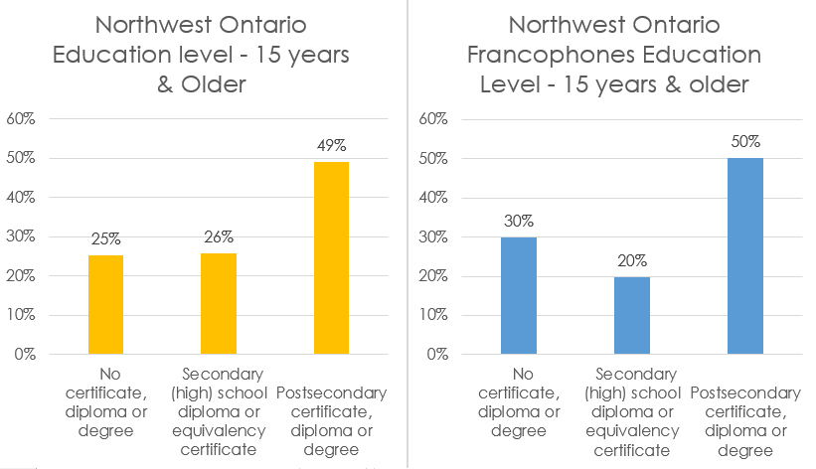
Data & Descriptive Statistics: Education – Northwest Ontario
Source: Author's calculations based on Statistics Canada, Target group profile of the Francophone population, Census, 2016, and Authors calculations based on Statistics Canada, Census of Population, 2016

Slide 16
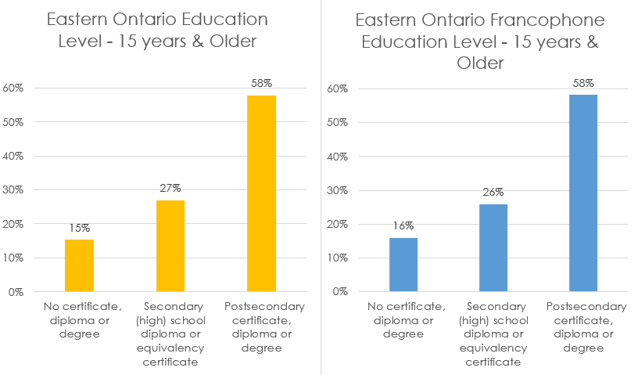
Data & Descriptive Statistics: Education – Eastern Ontario
Source: Author's calculations based on Statistics Canada, Target group profile of the Francophone population, Census, 2016, and Authors calculations based on Statistics Canada, Census of Population, 2016

Slide 17
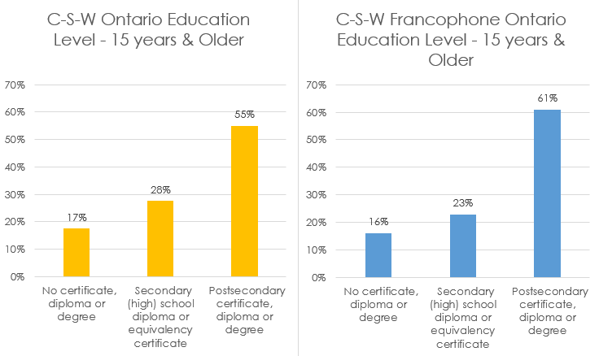
Data & Descriptive Statistics: Education – C-S-W Ontario
Source: Author's calculations based on Statistics Canada, Target group profile of the Francophone population, Census, 2016, and Authors calculations based on Statistics Canada, Census of Population, 2016

Slide 18
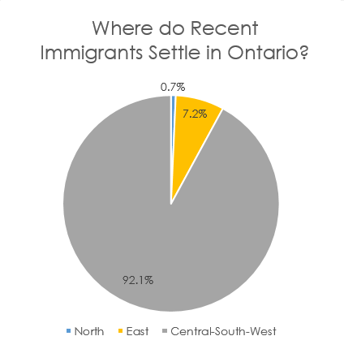
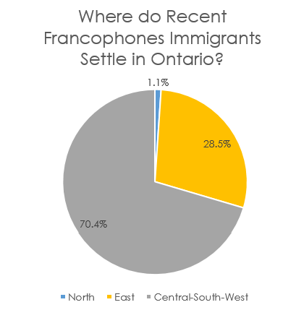
Data & Descriptive Statistics: Immigration
Source: Author's calculations based on Statistics Canada, Target group profile of the Francophone population, Census, 2016, and Authors calculations based on Statistics Canada, Census of Population, 2016

Slide 19
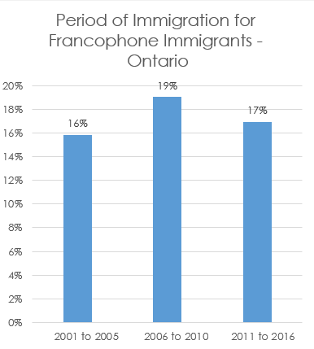
Data & Descriptive Statistics: Immigration
48% of Francophone immigrants in Ontario immigrated before 2001
Source: Author's calculations based on Statistics Canada, Target group profile of the Francophone population, Census, 2016, and Authors calculations based on Statistics Canada, Census of Population, 2016

Slide 20
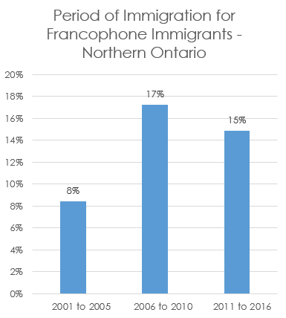
Data & Descriptive Statistics: Immigration
62% of Francophone immigrants in Northern Ontario immigrated before 2001
Source: Author's calculations based on Statistics Canada, Target group profile of the Francophone population, Census, 2016, and Authors calculations based on Statistics Canada, Census of Population, 2016

Slide 21
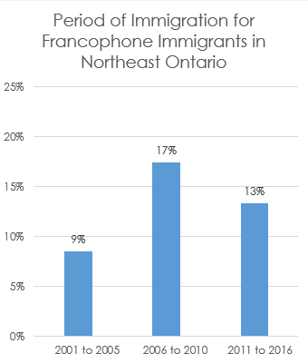
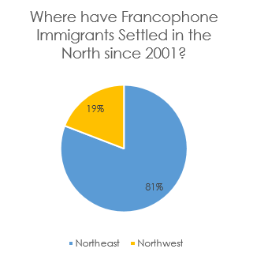
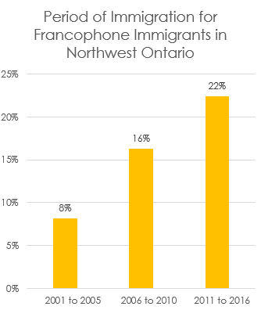
Data & Descriptive Statistics: Immigration
A total of 600 Francophone Immigrants have settled in the North since 2001
Source: Author's calculations based on Statistics Canada, Target group profile of the Francophone population, Census, 2016, and Authors calculations based on Statistics Canada, Census of Population, 2016

Slide 22
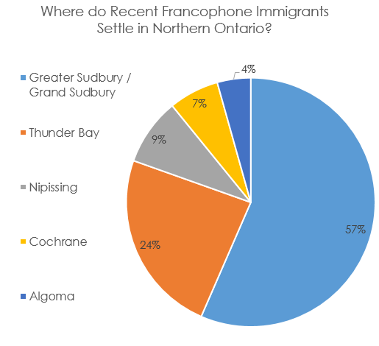
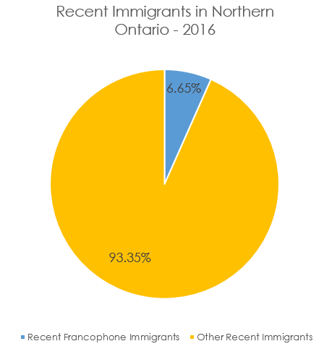
Data & Descriptive Statistics: Immigration
There are a total of 230 Francophones classified as recent immigrants* in Northern Ontario.
*Recent immigrants are those who settled less than 5 years before the time of the census.
Source: Author's calculations based on Statistics Canada, Target group profile of the Francophone population, Census, 2016, and Authors calculations based on Statistics Canada, Census of Population, 2016

Slide 23
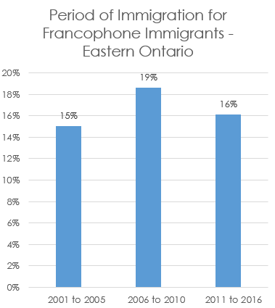
Data & Descriptive Statistics: Immigration
50% of Francophone immigrants in Eastern Ontario immigrated before 2001
Source: Author's calculations based on Statistics Canada, Target group profile of the Francophone population, Census, 2016, and Authors calculations based on Statistics Canada, Census of Population, 2016

Slide 24
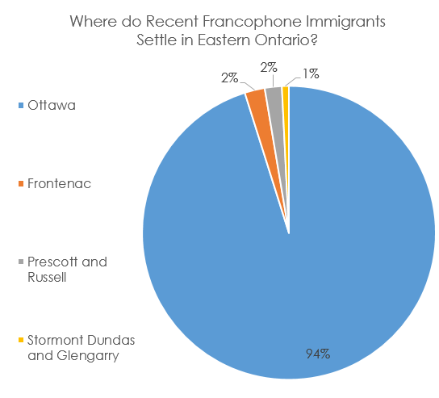
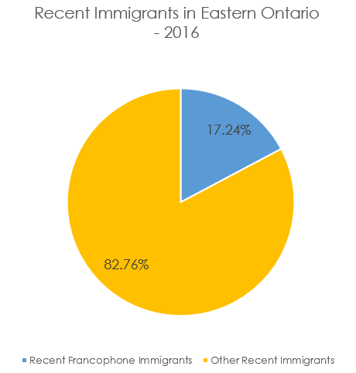
Data & Descriptive Statistics: Immigration
There are a total of 5915 Francophones classified as recent immigrants in Eastern Ontario.
Source: Author's calculations based on Statistics Canada, Target group profile of the Francophone population, Census, 2016, and Authors calculations based on Statistics Canada, Census of Population, 2016

Slide 25
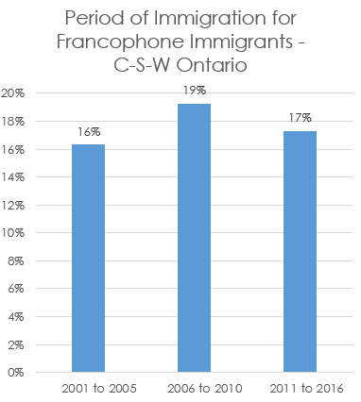
Data & Descriptive Statistics: Immigration
47% of Francophone immigrants in C-S-W Ontario immigrated before 2001
Source: Author's calculations based on Statistics Canada, Target group profile of the Francophone population, Census, 2016, and Authors calculations based on Statistics Canada, Census of Population, 2016

Slide 26
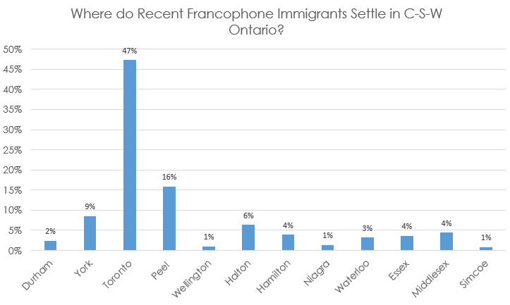
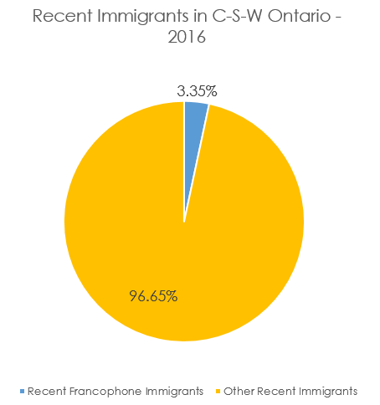
Data & Descriptive Statistics: Immigration
There are a total of 14570 Francophones classified as recent immigrants in C-S-W Ontario.
Source: Author's calculations based on Statistics Canada, Target group profile of the Francophone population, Census, 2016, and Authors calculations based on Statistics Canada, Census of Population, 2016

Slide 27
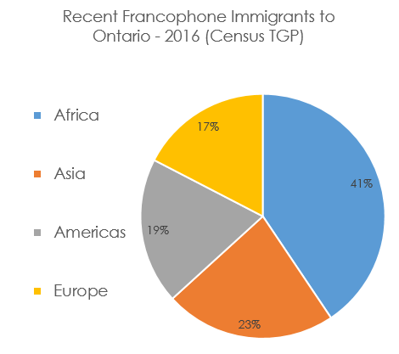
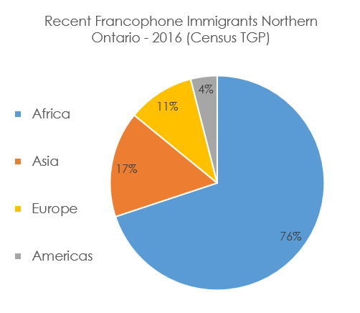
Data & Descriptive Statistics: Immigrant country of origin
Source: Author's calculations based on Statistics Canada, Target group profile of the Francophone population, Census, 2016, and Authors calculations based on Statistics Canada, Census of Population, 2016

Slide 28
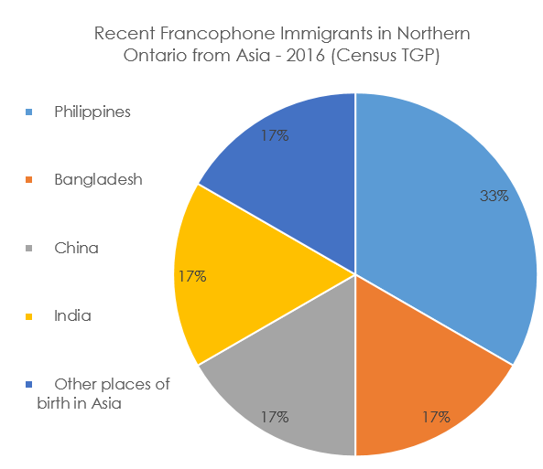
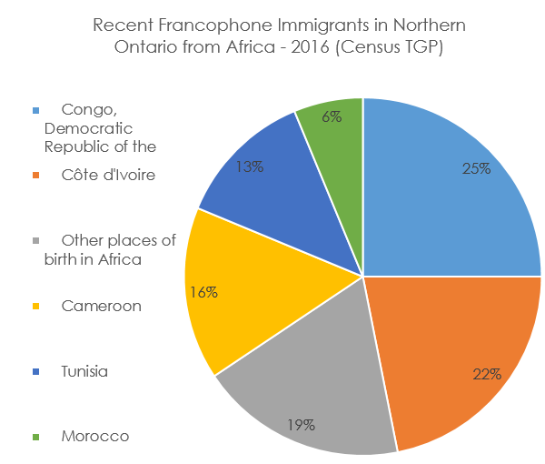
Data & Descriptive Statistics: Immigrant country of origin
Source: Author's calculations based on Statistics Canada, Target group profile of the Francophone population, Census, 2016, and Authors calculations based on Statistics Canada, Census of Population, 2016

Slide 29
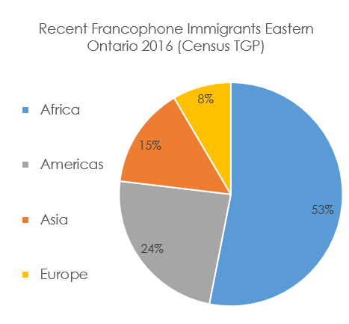
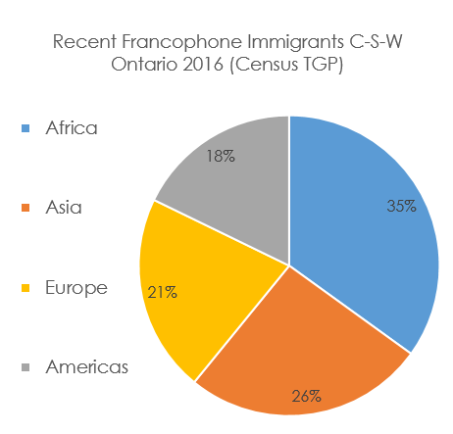
Data & Descriptive Statistics: Immigrant country of origin
Source: Author's calculations based on Statistics Canada, Target group profile of the Francophone population, Census, 2016, and Authors calculations based on Statistics Canada, Census of Population, 2016

Slide 30
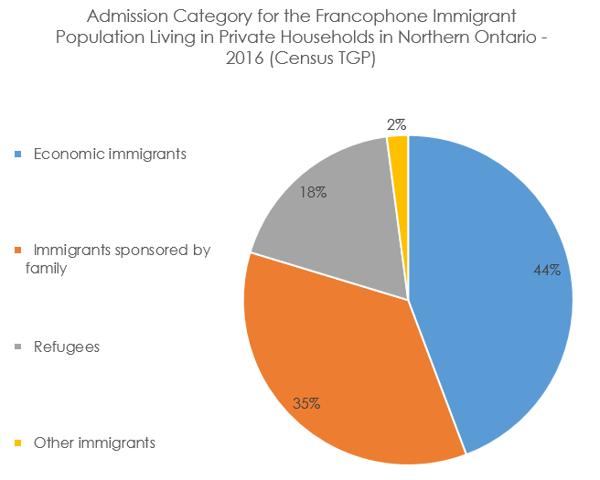
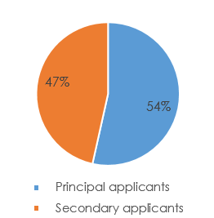
Data & Descriptive Statistics: Immigration admission category
Economic Immigrant subcategory:
Source: Author's calculations based on Statistics Canada, Target group profile of the Francophone population, Census, 2016, and Authors calculations based on Statistics Canada, Census of Population, 2016

Slide 31
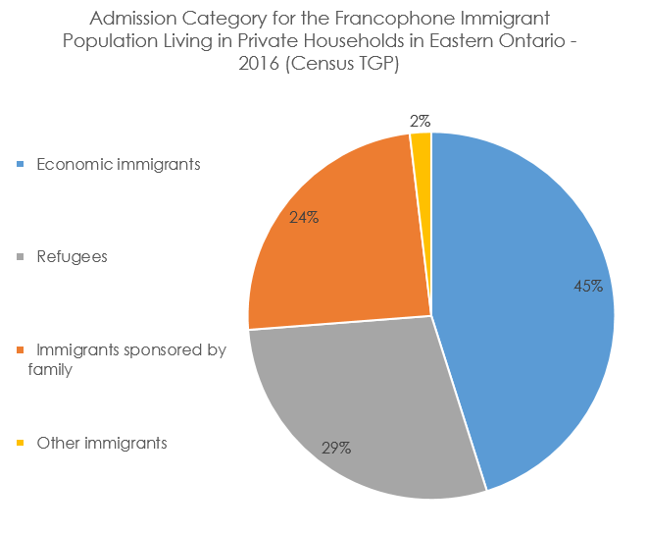
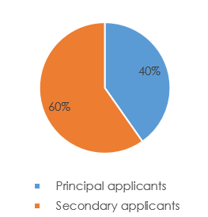
Data & Descriptive Statistics: Immigration admission category
Economic Immigrant subcategory:
Source: Author's calculations based on Statistics Canada, Target group profile of the Francophone population, Census, 2016, and Authors calculations based on Statistics Canada, Census of Population, 2016

Slide 32
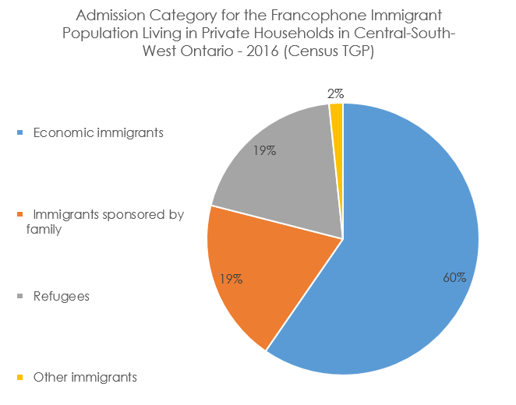
Data & Descriptive Statistics: Immigration admission category
Economic Immigrant subcategory:
Source: Author's calculations based on Statistics Canada, Target group profile of the Francophone population, Census, 2016, and Authors calculations based on Statistics Canada, Census of Population, 2016

Slide 33
Labour Market Analysis: Capacity to Identify Francophone Jobs
Talent Neuron software:
Used for identifying job postings by NOC & specified geography
Used as a proxy or sample for demand
Available through Local Employment Planning Councils/ Workforce Development Boards
Can search for terms within job postings such as “French” &“Bilingual”
Barriers:
Does not include Indeed for legal reasons
Cannot identify jobs in which no English is required

Slide 34
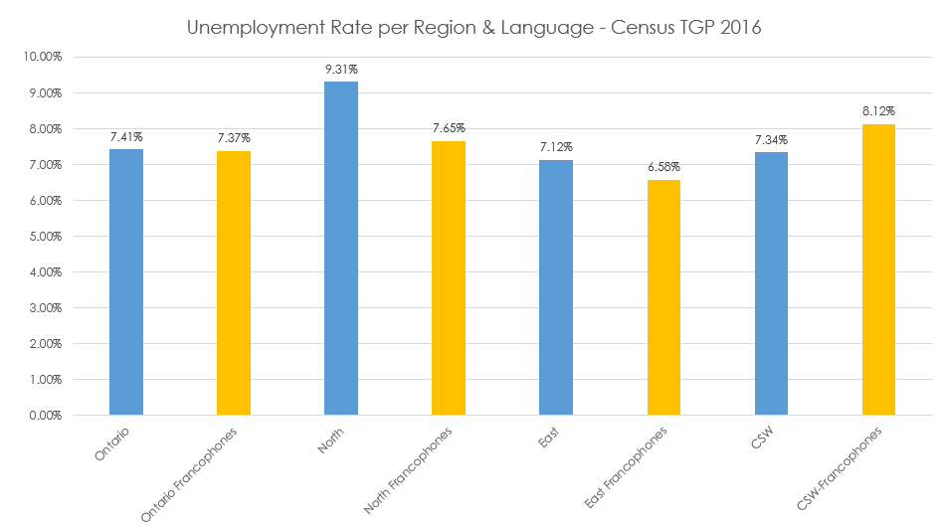
Labour Market Analysis: Unemployment
Source: Author's calculations based on Statistics Canada, Target group profile of the Francophone population, Census, 2016, and Authors calculations based on Statistics Canada, Census of Population, 2016

Slide 35
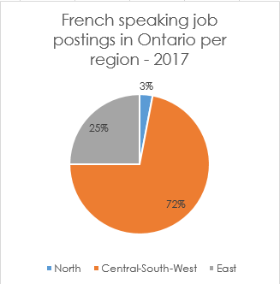
Labour Market Analysis: Ontario Summary
Total of 22 348 French speaking job postings found in Ontario 2017
Source: Author calculations based on LMI report prepared for NPI by A. Bell of the Workforce Development Board (Peterborough)

Slide 36
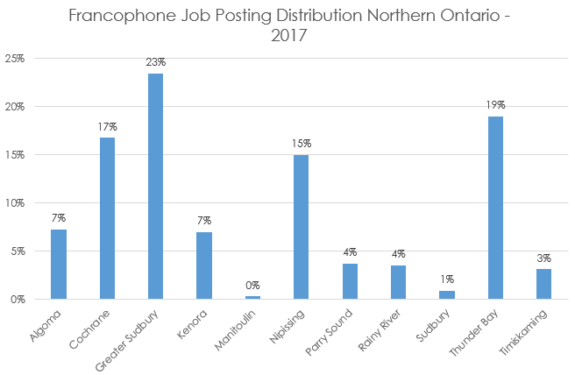
Labour Market Analysis: Northern Ontario Summary
Total of 674 French speaking job postings found in Northern Ontario 2017, representing 3% of all job postings in this region.
70% found in the Northeast
30% found in the Northwest
Source: Author’s calculations based on LMI report prepared for NPI by A. Bell of the Workforce Development Board (Peterborough)

Slide 37
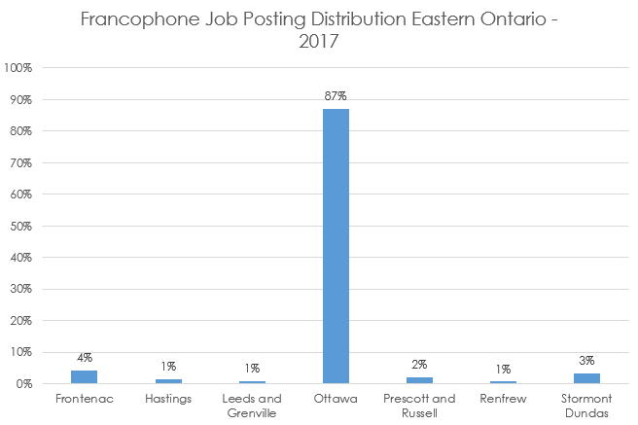
Labour Market Analysis: Eastern Ontario Summary
Total of 5640 French speaking job postings found in Eastern Ontario 2017, representing 7% of all job postings in this region.
Source: Author’s calculations based on LMI report prepared for NPI by A. Bell of the Workforce Development Board (Peterborough)

Slide 38
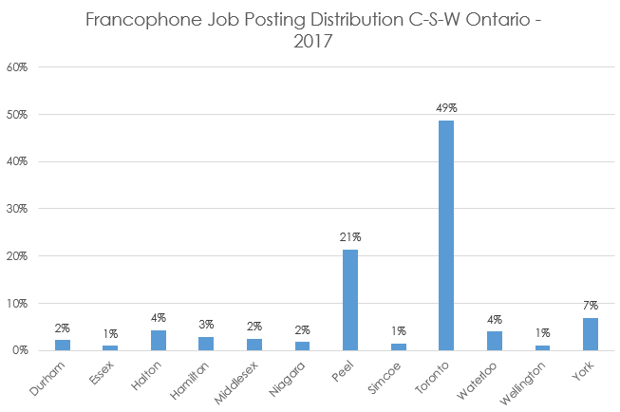
Labour Market Analysis: C-S-W Ontario Summary
Total of 16 034 French speaking job postings found in
C-S-W Ontario 2017, representing 3% of all job postings in this region.
Source: Author’s calculations based on LMI report prepared for NPI by A. Bell of the Workforce Development Board (Peterborough)

Slide 39
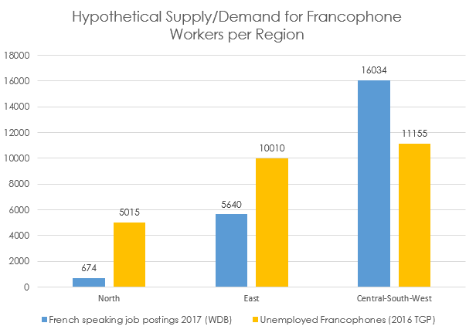
Labour Market Analysis: Proxy for Demand per region
Source: Statistics Canada, Target group profile of the Francophone population, Census, 2016, and LMI report prepared for NPI by A. Bell of the Workforce Development Board (Peterborough)

Slide 40
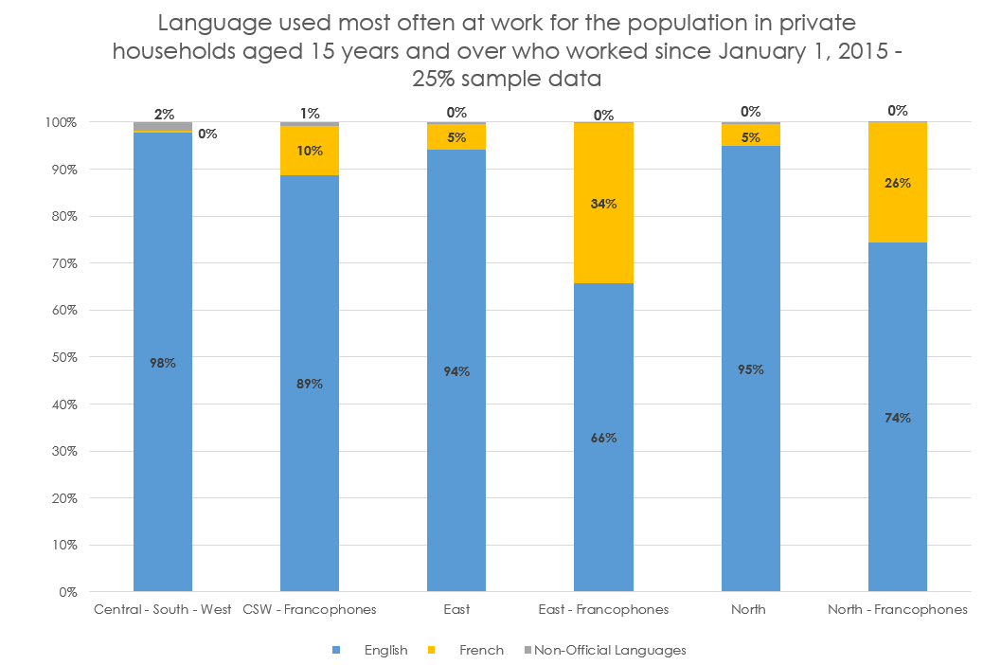
Labour Market Analysis: Who is working in French?
Source: Author's calculations based on Statistics Canada, Target group profile of the Francophone population, Census, 2016, and Authors calculations based on Statistics Canada, Census of Population, 2016

Slide 41
Labour Market Analysis: Occupation demand per region
UNIQUE TO THE NORTH:
7% of the total demand for francophone workers in Northern Ontario is in the occupation Industrial & Manufacturing Engineers (NOC 2141), compared to <0.5% in the East and C-S-W
The occupation with the highest total demand for francophone workers in the North is, Other customer and information services representatives (NOC 6552), at 26% compared to 22% in the C-S-W & 11% in the East
Northern Ontario
The occupation with the second highest total demand for francophone workers in the North is, Retail salespersons (NOC 6421), at 12% , compared to11% in the C-S-W & 7% in the East
This occupation represents the highest total demand in all 3 regions
Source: Author’s calculations based on LMI report prepared for NPI by A. Bell of the Workforce Development Board (Peterborough)

Slide 42
Labour Market Analysis: Occupation demand per region
The occupation with the second highest total demand for francophone workers in the East is, Social and community service workers (NOC 4212), at 9%, compared to 2% in the North and CSW respectively
East
UNIQUE TO THE EAST:
The occupation with the third highest total demand for francophone workers in the East is, Customer and information services supervisors,(NOC 6314) at 8%, compared to <0.5% in the North and CSW respectively
The occupation with the fourth highest total demand is Bus drivers, subway operators and other transit operators (NOC 7152) at 5%, compared to <0.5% in the North and CSW respectively
Source: Author’s calculations based on LMI report prepared for NPI by A. Bell of the Workforce Development Board (Peterborough)

Slide 43

Labour Market Analysis: Occupation demand per region
The occupation with the second highest total demand for francophone workers in the CSW is Retail salespersons, (NOC 6421) at 11%
UNIQUE TO THE C-S-W:
The occupation with the third highest total demand for francophone workers in the C-S-W is, Advertising, marketing and public relations managers,(NOC 0124) at 4%, compared to 1% in the North and East respectively
Source: Author’s calculations based on LMI report prepared for NPI by A. Bell of the Workforce Development Board (Peterborough)

Slide 44
Labour Market Analysis: Industry analysis
% of Jobs postings per region within industries with a high average fraction of demand for French speakers in all 3 regions:
Industry | East | North | C-S-W
Business Support Services | 1% | 2% | 3%
Depository Credit Intermediation | 7% | 3% | 4%
General Medical and Surgical Hospitals | 1% | 5% | 2%
Home Health Care Services | 9% | 1% | 2%
Individual and Family Services | 1% | 4% | 1%
Management of Companies and Enterprises | 3% | 7% | 3%
Management, Scientific, and Technical Consulting Services | 2% | 4% | 2%
Other Telecommunications | 3% | 5% | 7%
Source: LMI report prepared for NPI by A. Bell of the Workforce Development Board (Peterborough)

Slide 45
Labour Market Analysis: Industry analysis
Northern Ontario: Unique to the North
10% of french speaking job postings in the North are in the Sawmill and Wood Preservation Industry
3% of french speaking job postings in the North are in the Specialty Food Stores Industry
2% of french speaking job postings in the North are in the Pulp, Paper, and Paperboard Mills Industry
2% of French speaking job postings in the North are in the Investigation and Security Services Industry
Source: LMI report prepared for NPI by A. Bell of the Workforce Development Board (Peterborough)

Slide 46
Labour Market Analysis: Industry analysis
Eastern Ontario: Unique to the East
5% of french speaking job postings in the East are in the School and Employee Bus Transportation Industry
5% of french speaking job postings in the East are in the
Othe Schools and Instruction Industry
3% of french speaking job postings in the East are in the Offices of Physicians Industry
Source: LMI report prepared for NPI by A. Bell of the Workforce Development Board (Peterborough)

Slide 47
Labour Market Analysis: Industry analysis
C-S-W Ontario: Unique to the C-S-W
3% of french speaking job postings in the C-S-W are in the
Other Professional, Scientific, and Technical Industry
2% of french speaking job postings in the C-S-W are in the
Electronic and Appliance Stores Industry
2% of french speaking job postings in the C-S-W are in the
Insurance Carriers Industry
2% of french speaking job postings in the C-S-W are in the
Pipeline Transportation of Natural Gas Industry
2% of french speaking job postings in the C-S-W are in the
Social Advocacy Organziations Industry
Source: LMI report prepared for NPI by A. Bell of the Workforce Development Board (Peterborough)

